Slide 1
Using LMS Engagement to Predict Drop Out Rates
Understanding Drop-out rates using LMS Data
Group 1
Leduna, Maclang, Malaluan, Pausal, Ullegue

Slide 2
What causes drop out rates?

Slide 3
User Engagement with the LMS
J.-T. Seo, B.-N. Bok, and K.-W. Yeon, “Analysis of LMS data of distance Lifelong Learning Center learners and drop-out prediction,” Journal of Human-centric Science and Technology Innovation, vol. 1, no. 3, pp. 23–32, Jul. 2021, doi: 10.21742/jhsti.2021.1.3.04.
Notes:
They explained the following:
-As the number of learning increases, the odds of drop out decreases
-To prevent the drop out of learners, it is necessary to induce the use of LMS

Slide 4
Data Collection:
Frequency of LMS Access
Time spent in the LMS
Assignment submissions and completion status
Quiz scores
Participation in online discussions or forums
Drop out labels

Slide 5
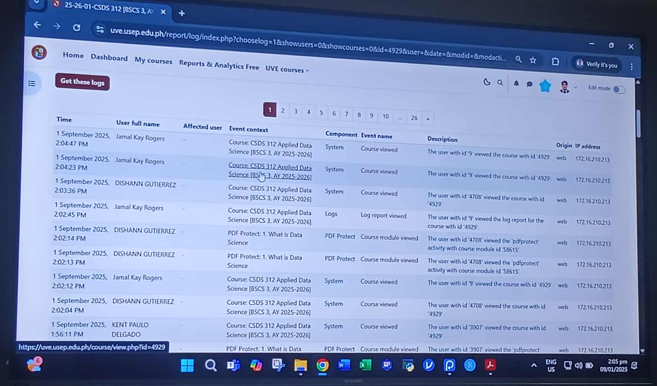
Data Collection:
Frequency of LMS Access

Slide 6
Data Collection:
2. Time spent in the LMS

Slide 7
Data Collection:
3. Assignment submissions and completion status

Slide 8
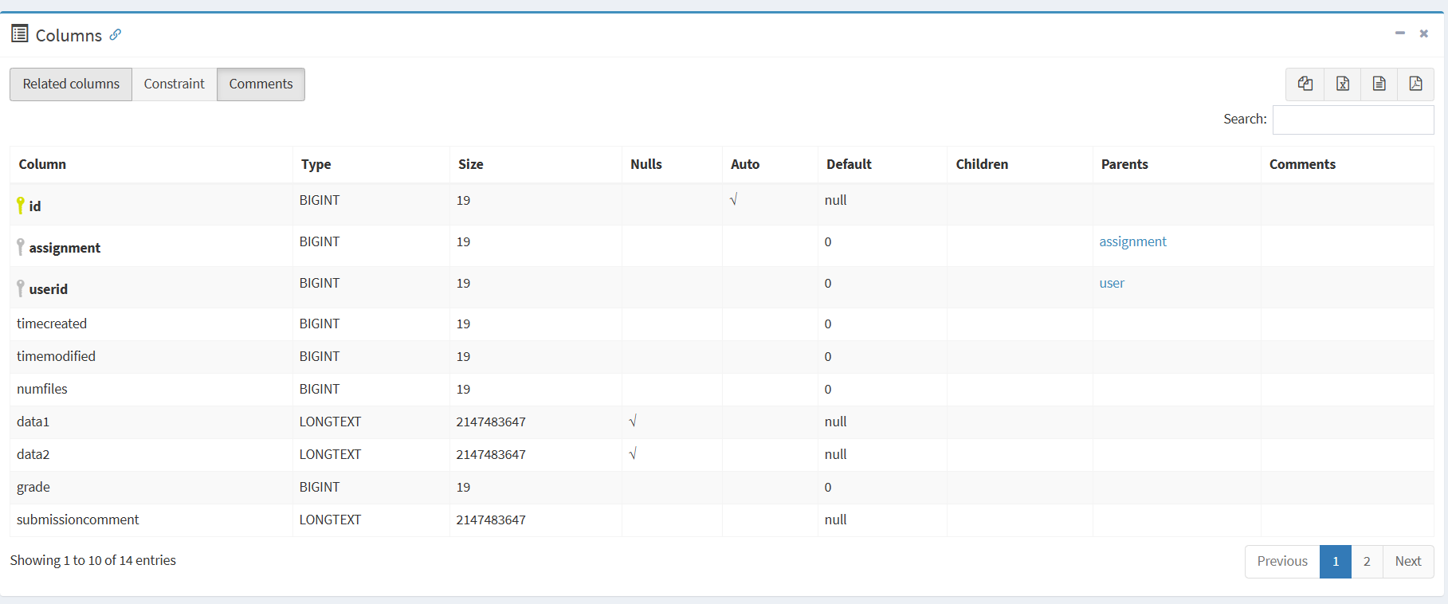
Data Collection:

Slide 9
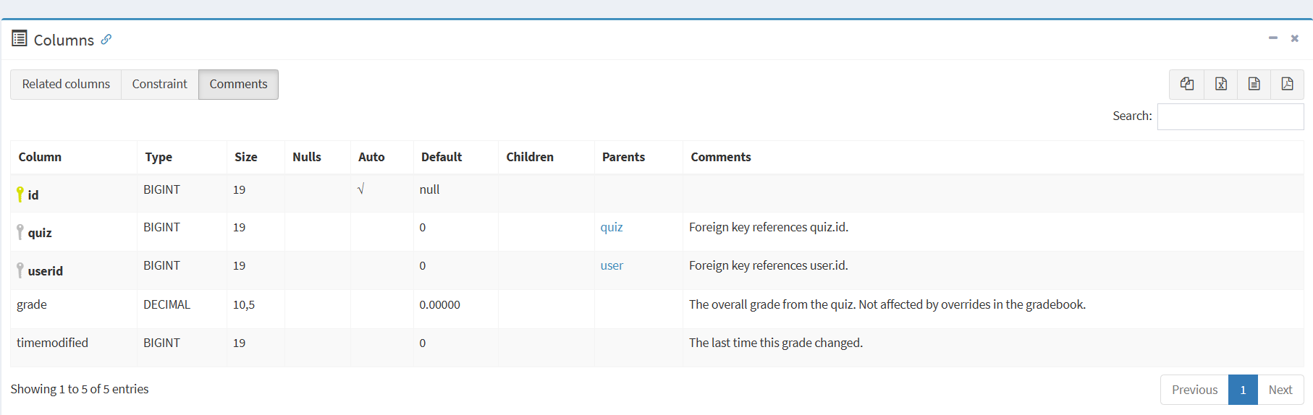
Data Collection:
4. Quiz scores

Slide 10
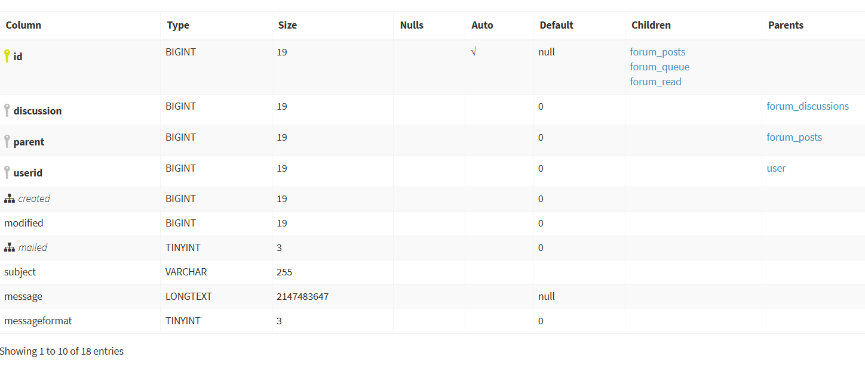
Data Collection:
5. Participation in online discussions or forums
Taken from the forum_posts table

Slide 11
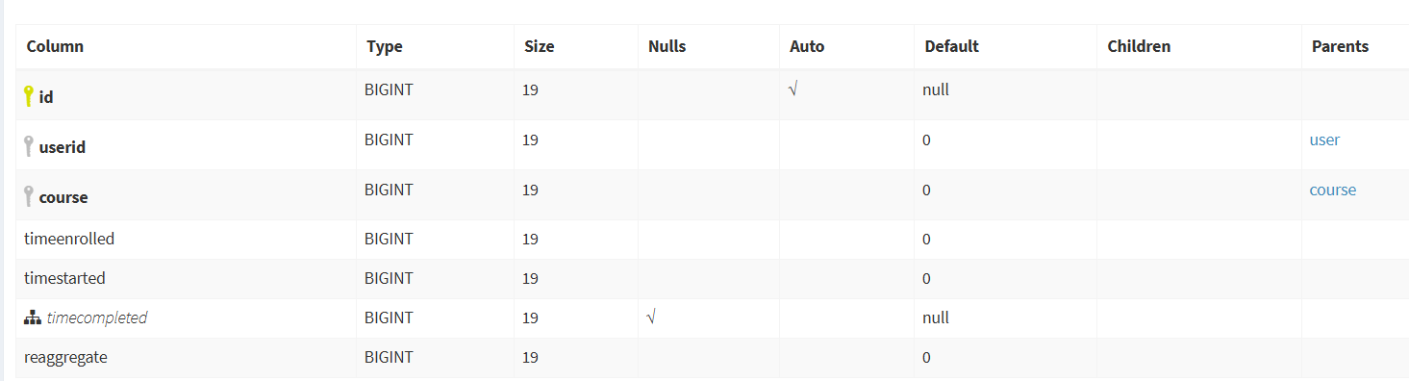
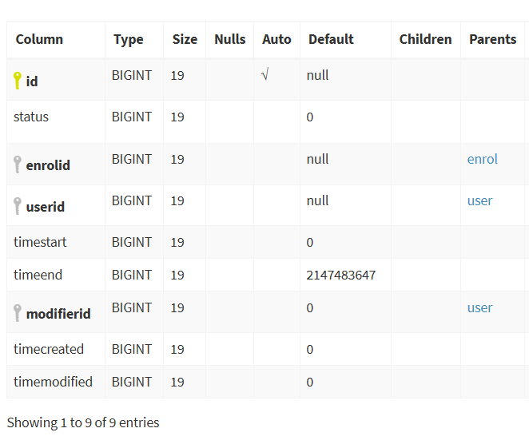
Data Collection:
6. Drop out labels
user_enrollments
course_completions

Slide 12
Data Preparation:
1. Data Cleaning
Formatting data such as dates and id(s) found in the logs

Slide 13
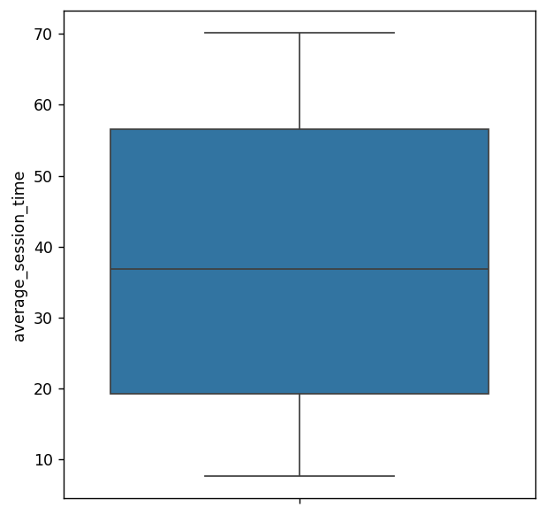
Data Preparation:
1. Data Cleaning
Finding and removing outliers

Slide 14
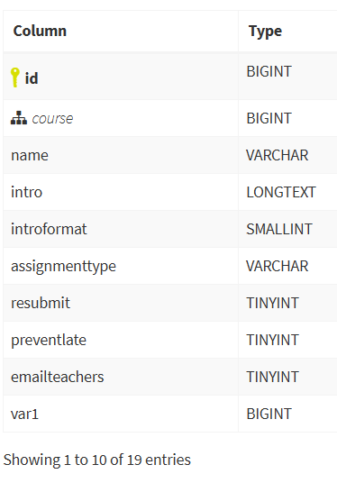
Data Preparation:
2. Feature Engineering
assignment_submissions
assignment
Notes:
Engagement Metrics (Logins per week)
Performance Metrics (Assignment completion and quiz score ratio)
Interaction Metrics (Discussion posts)

Slide 15
Data Preparation:
3. Label Definition
Drop outs in the dataset are listed as 1, otherwise 0

Slide 16
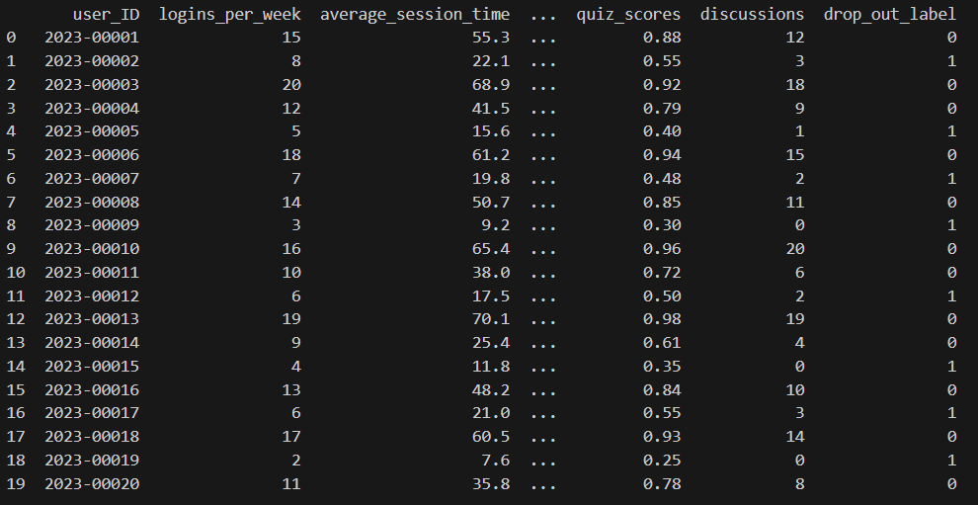
Data Preparation:
3. Finalized Dataset
Sample Dataset from Gemini

Slide 17
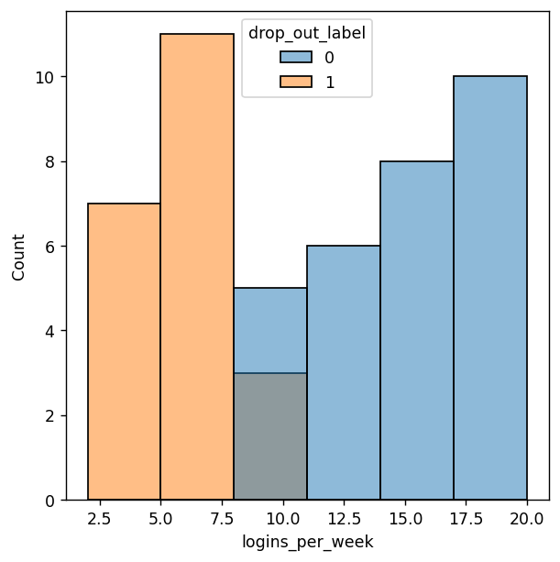
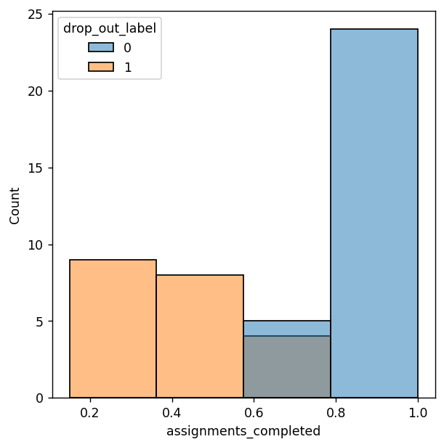
Data Visualization:
1. Univariate
Notes:
Login Frequency (Histogram): A histogram of weekly login counts shows that both dropouts and non-dropouts display very similar distributions. Since the two groups overlap heavily, login frequency alone is not a useful predictor of dropout.
* Assignment Completion (Bar Plot): In contrast, assignment completion rates reveal a clear separation: non-dropouts consistently complete assignments, while dropouts often fail to submit them. This makes assignment completion a stronger early-warning indicator compared to login frequency.

Slide 18
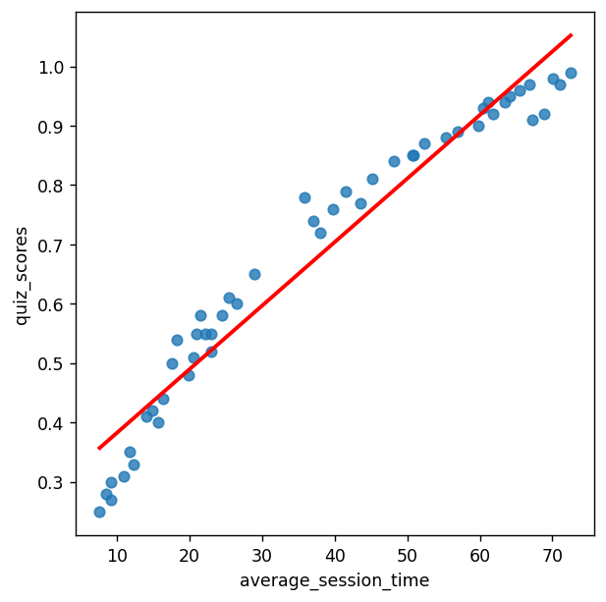
Data Visualization:
2. Bivariate
Relation between average session time and Quiz score
Notes:
* Average Session Time vs. Quiz Score (Scatterplot): When examining engagement more deeply, we see that the more time students spend in the virtual learning environment, the higher their quiz scores tend to be. This relationship highlights quality of engagement (time spent) as more meaningful than simple login counts.

Slide 19
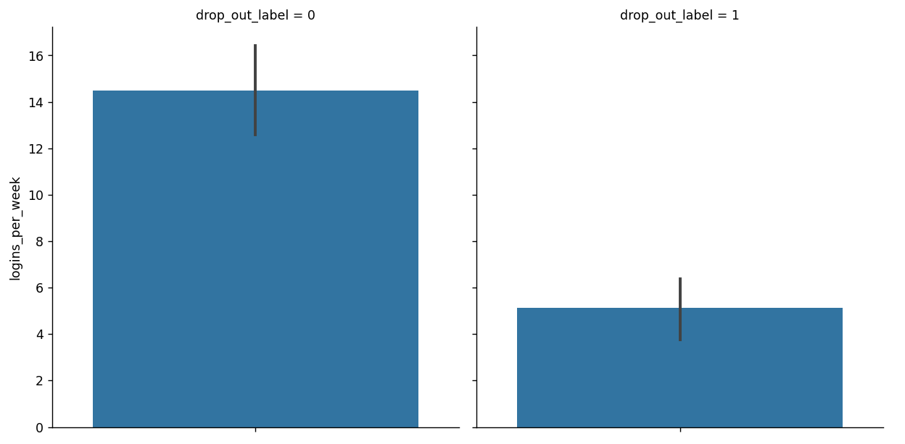
Data Visualization:
3. Insights
Notes:
Histogram vs. Bar Plot: The histogram of logins per week was not helpful because it showed both groups clustering in the same range, making it difficult to differentiate dropouts from non-dropouts. However, the bar plot of average quiz scores provides a much clearer contrast:
* Non-dropouts have an average quiz score above 14.
* Dropouts average below 6. This stark difference demonstrates why bar plots of performance-related metrics can be more effective than histograms of raw activity counts when identifying early-warning indicators.

Slide 20
Machine Learning:
For binary classification:
**Logistic Regression**
Random Forest
Neural Networks

Slide 21
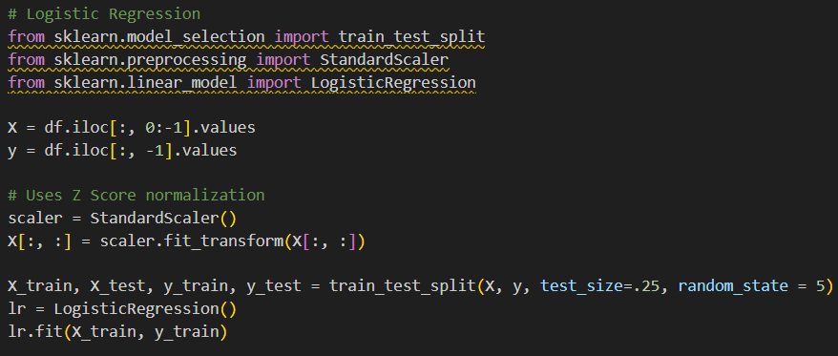
Machine Learning:
Training the data:

Slide 22
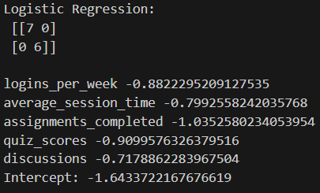
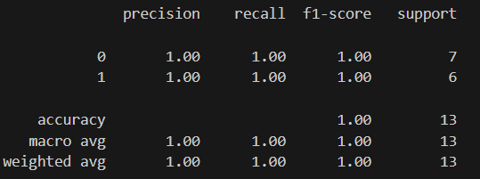
Machine Learning:
Model Evaluation:

Slide 23
Deployment:
Get the user_id from the LMS using their name
Using the user_id as reference, get the aggregate data using a complex query
Pass the collected data into the model

Slide 24
Communication of Results:
The more a student uses the LMS, specifically submits their assignments, while doing well in quizzes, and being active in forums/discussions, the lower the odds a student will drop out.
This can serve as a personalized warning for students at risk of dropping out.

Slide 25
Thank you for listening!

